Slide 1
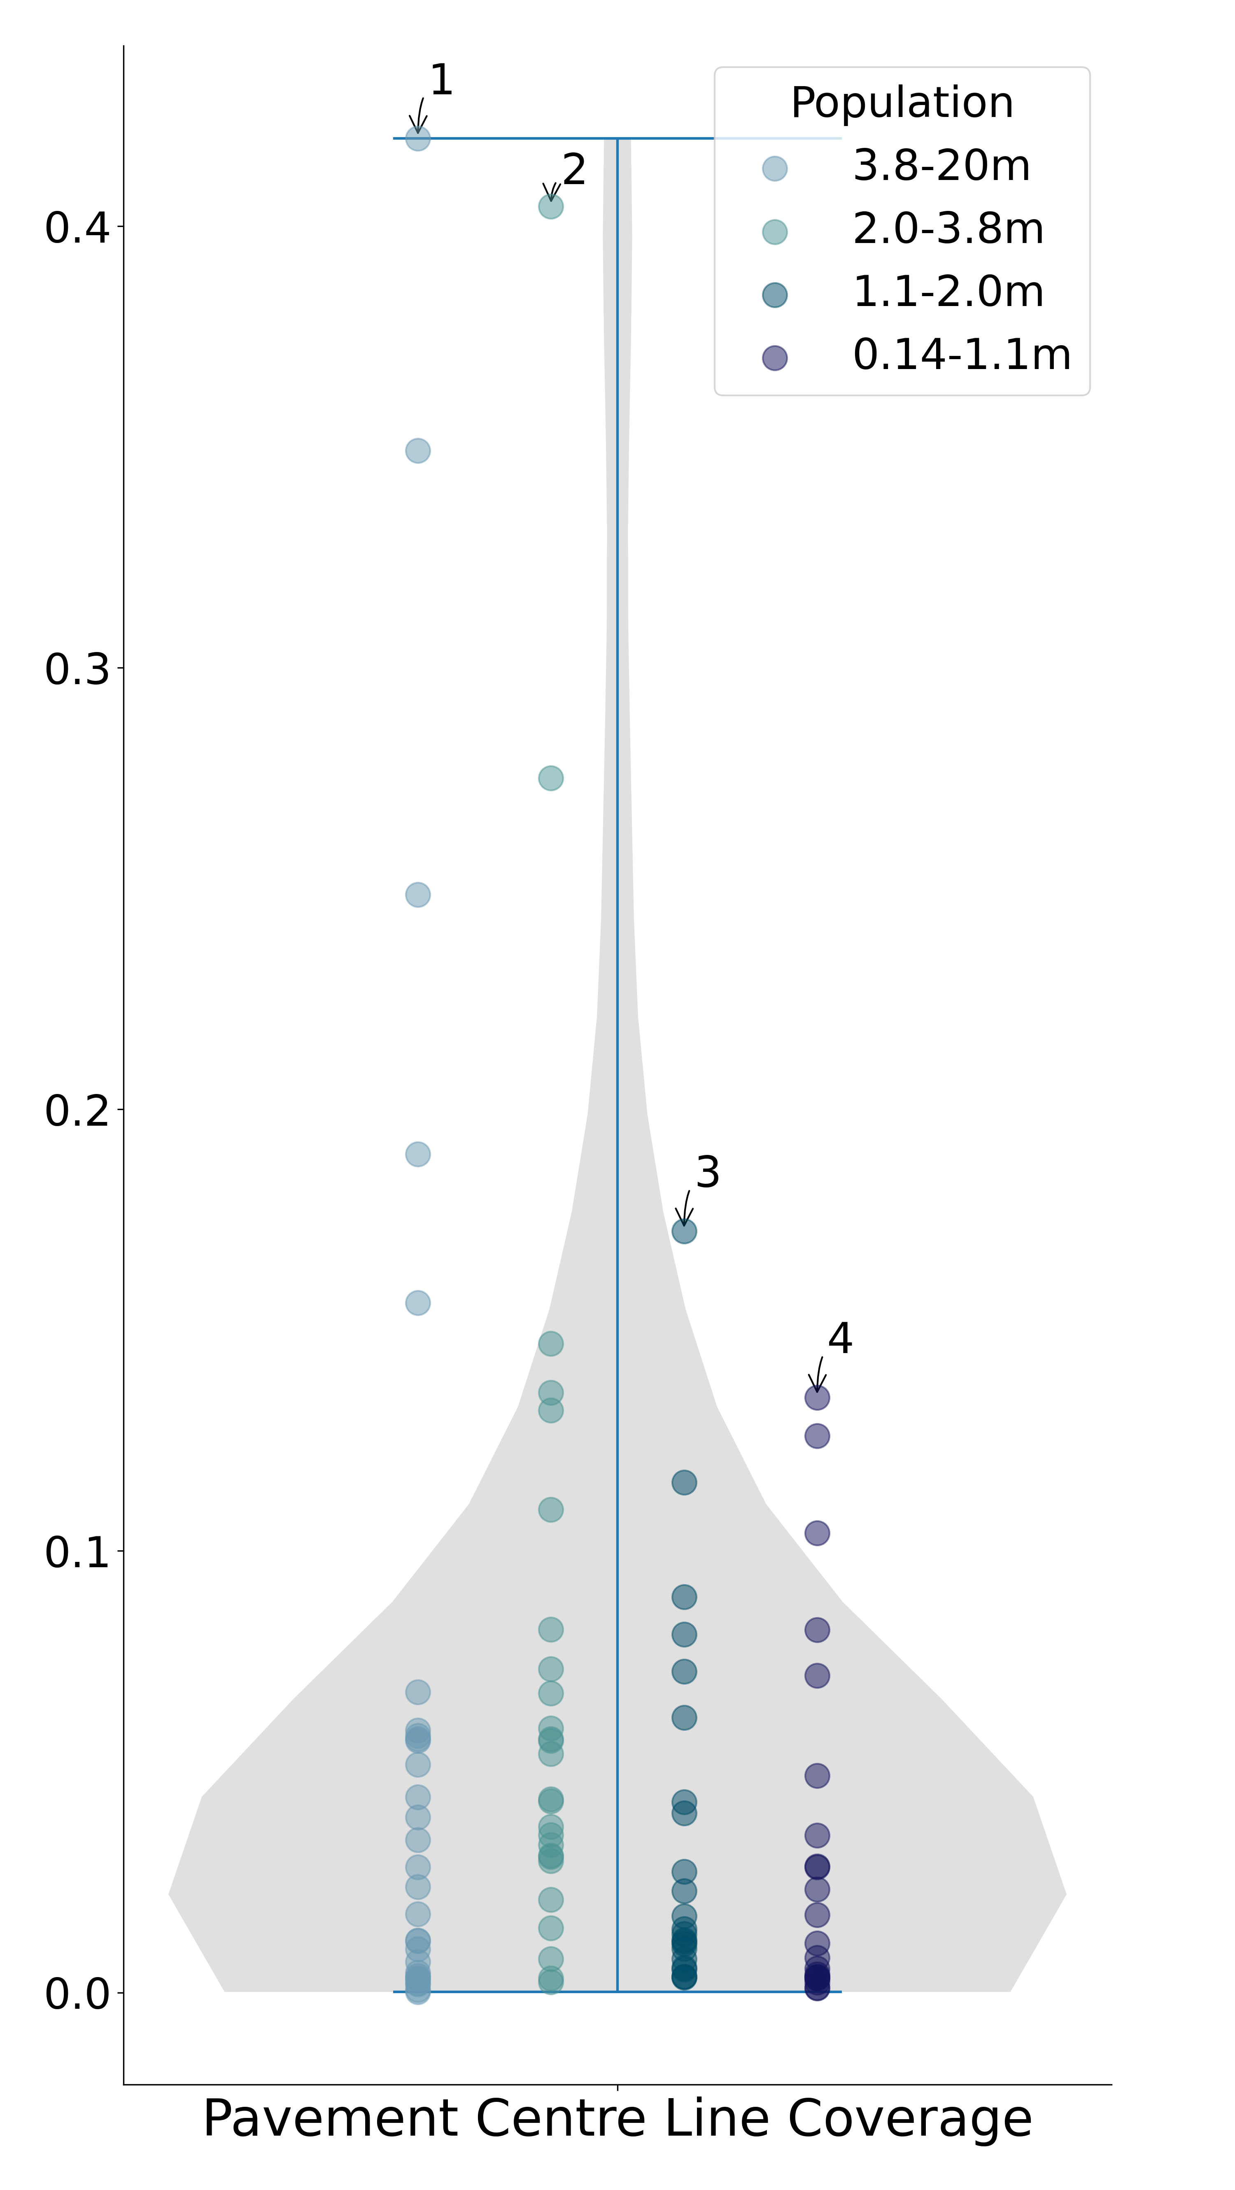
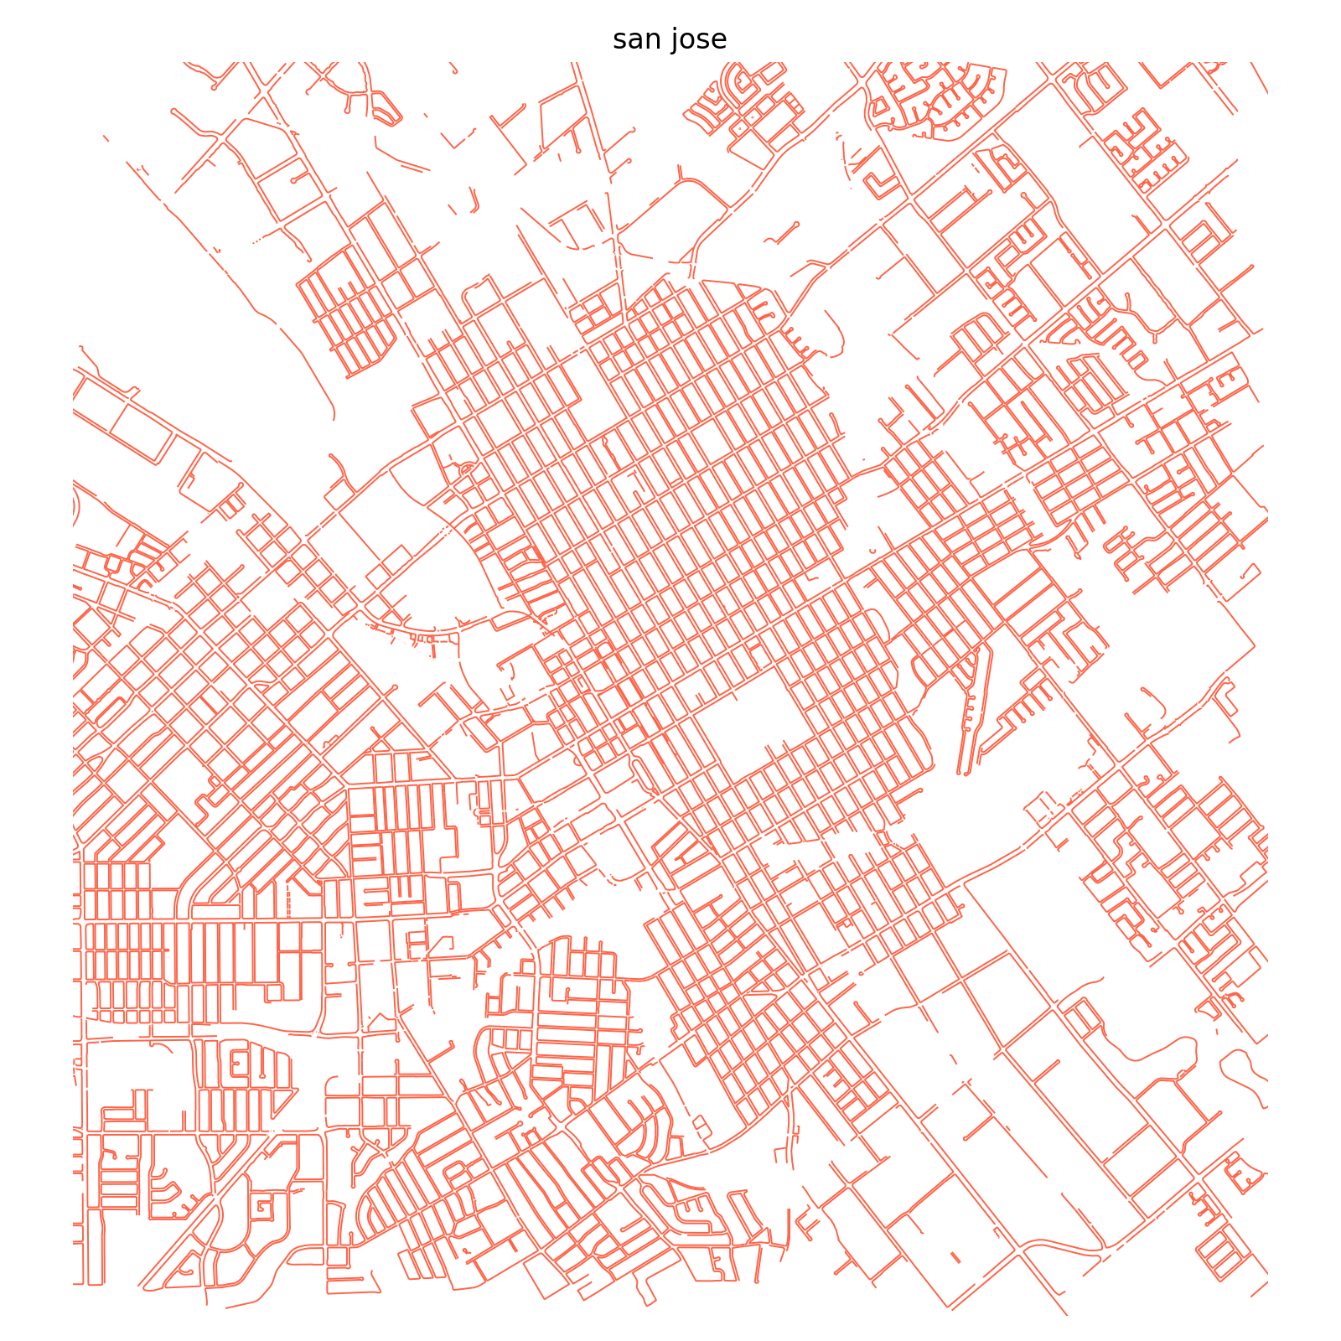
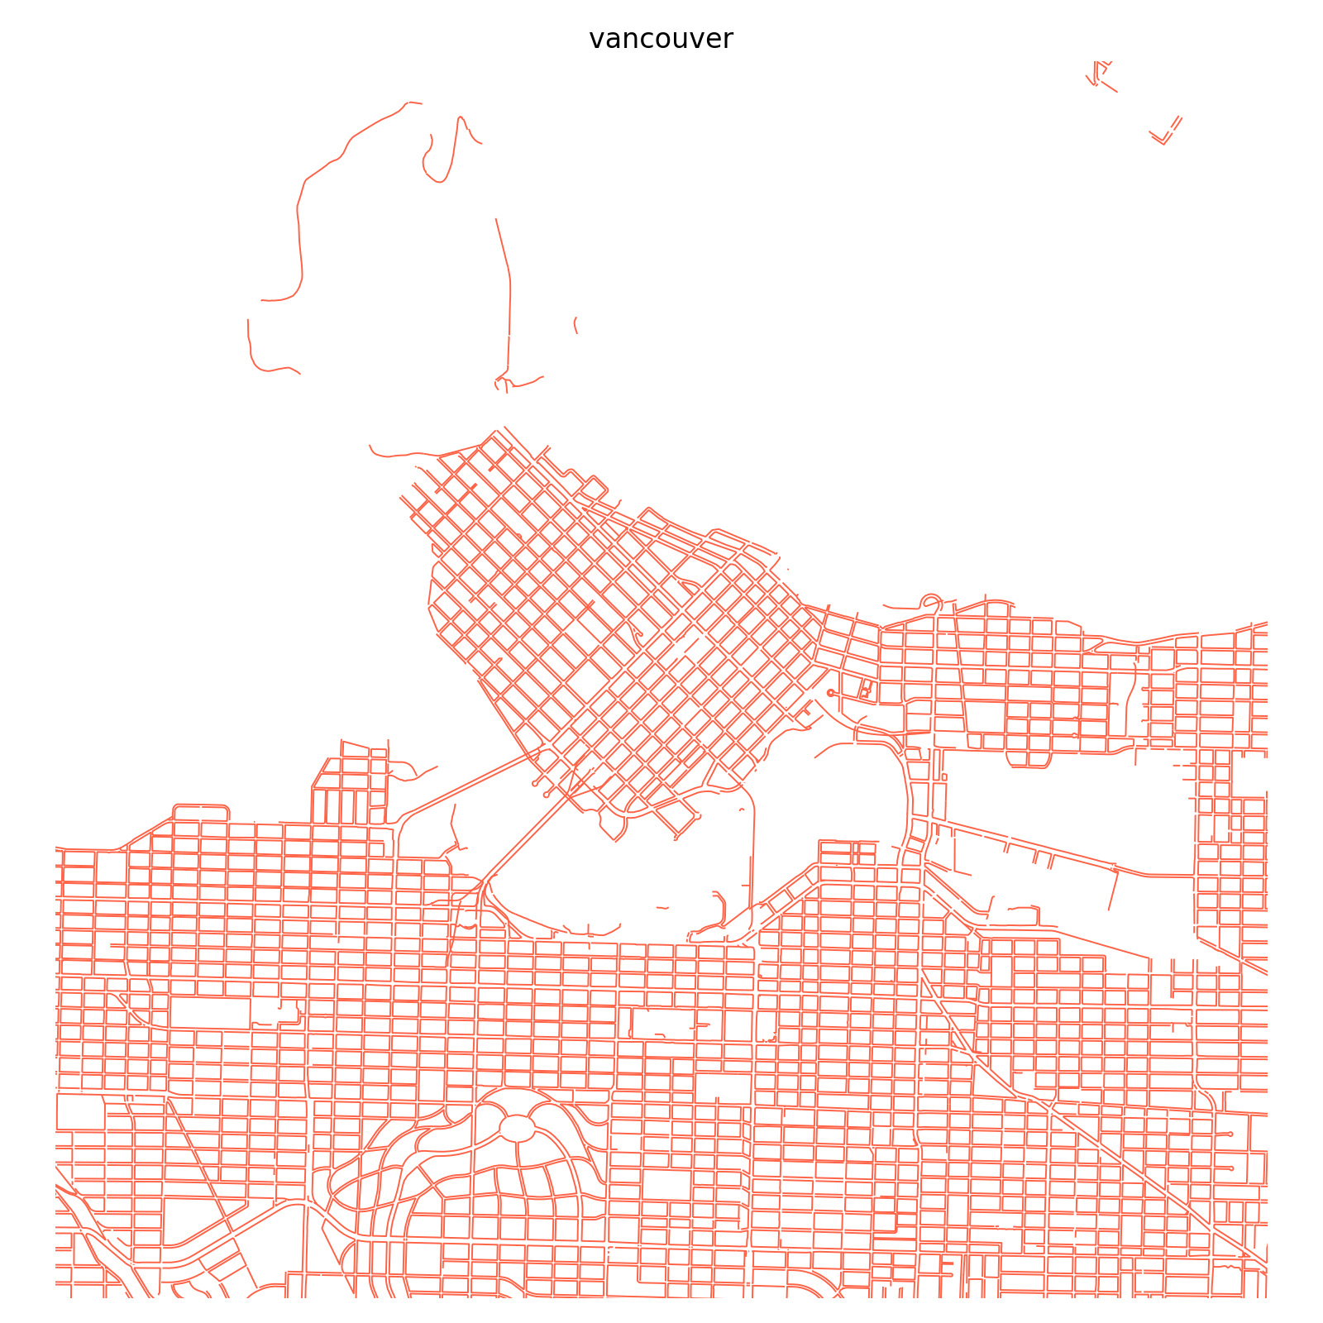
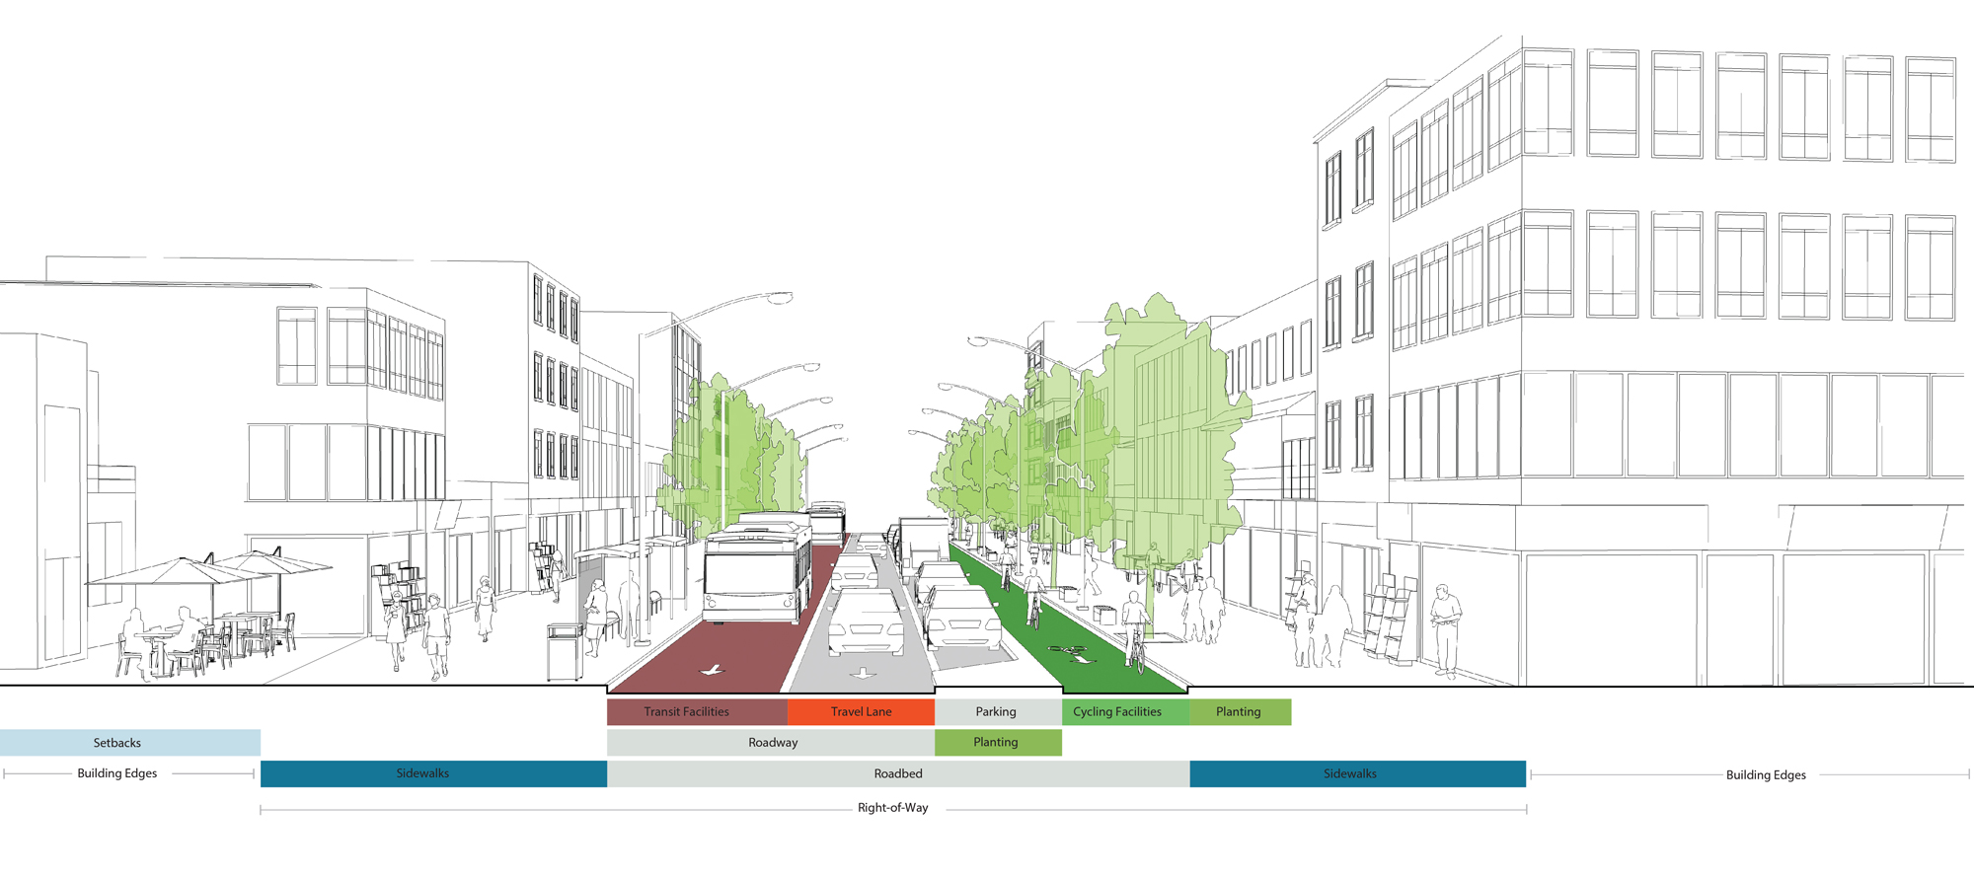
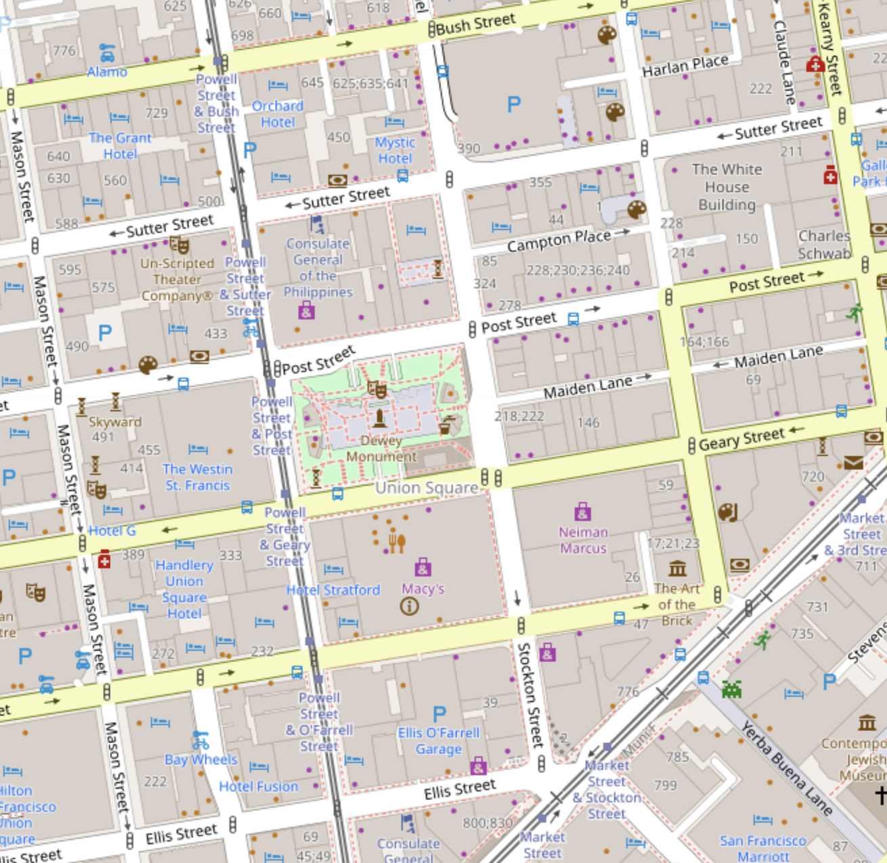
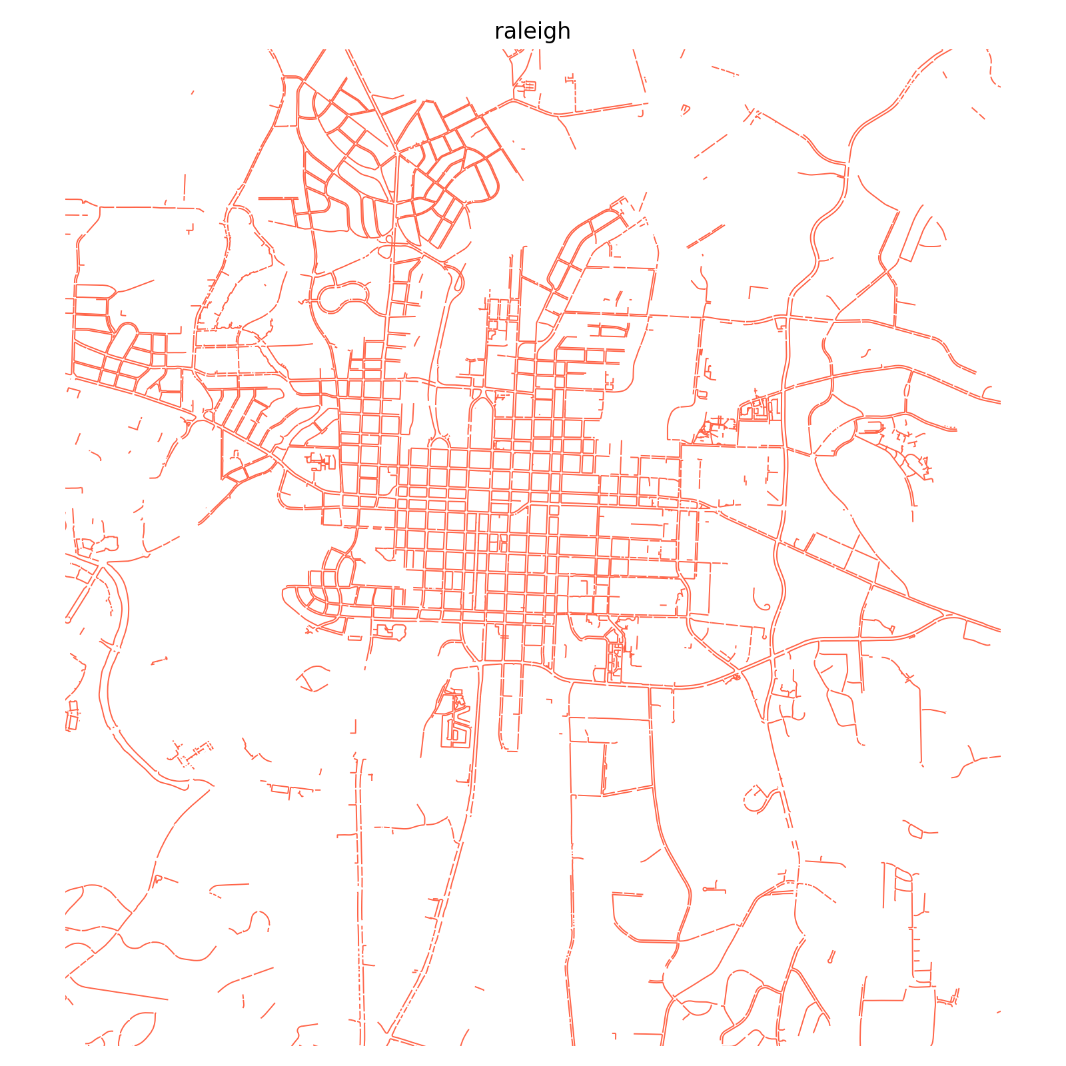
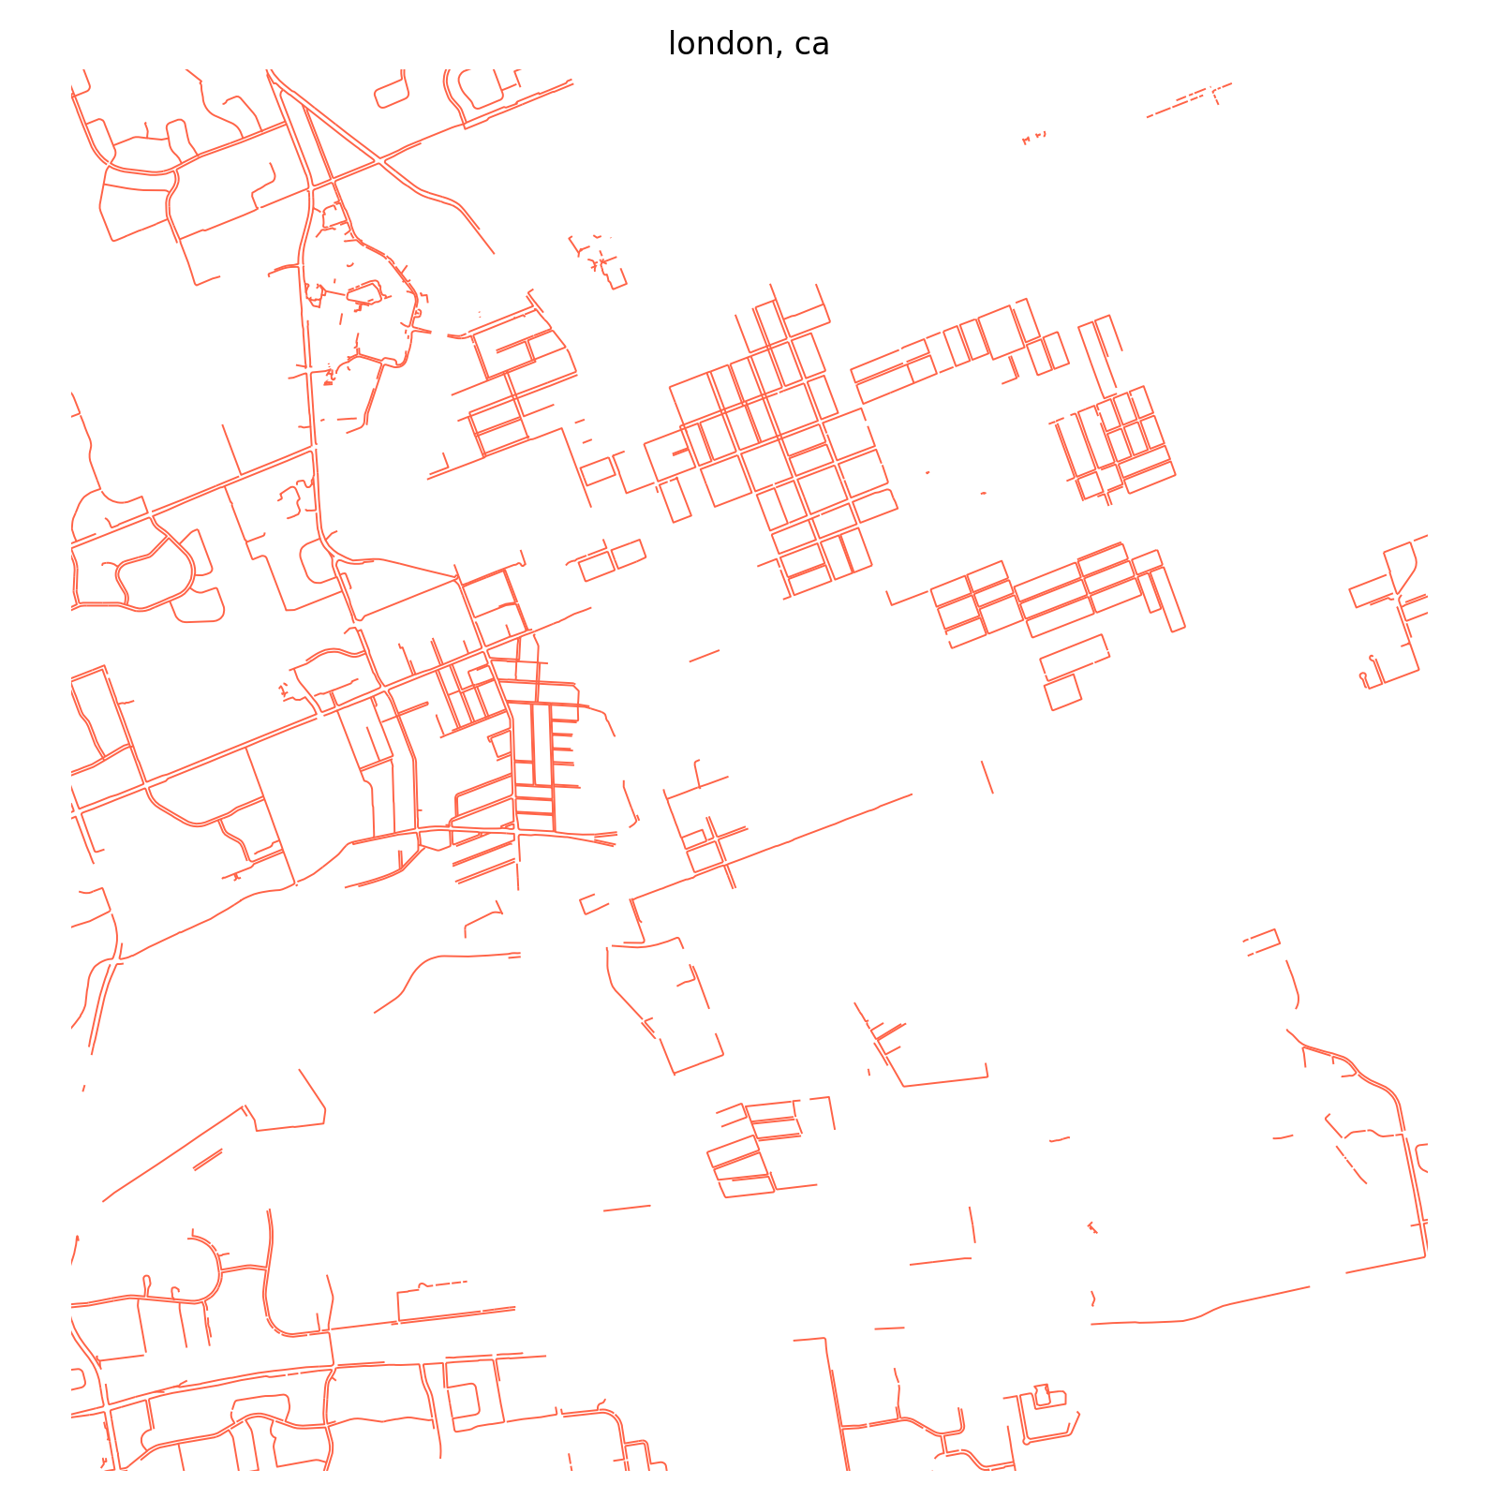
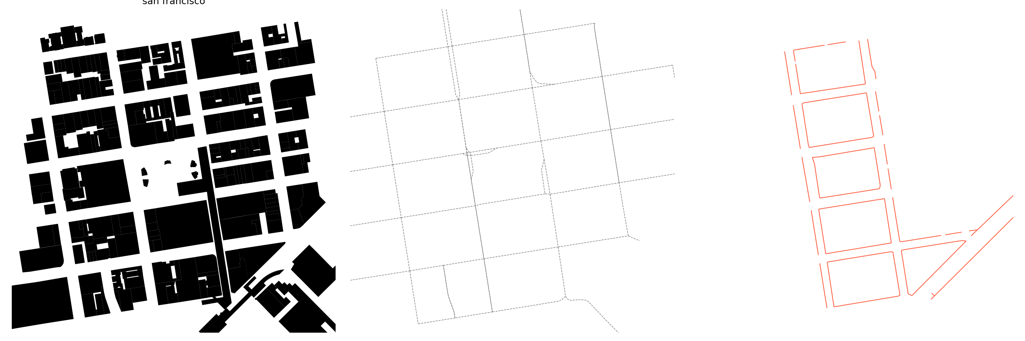
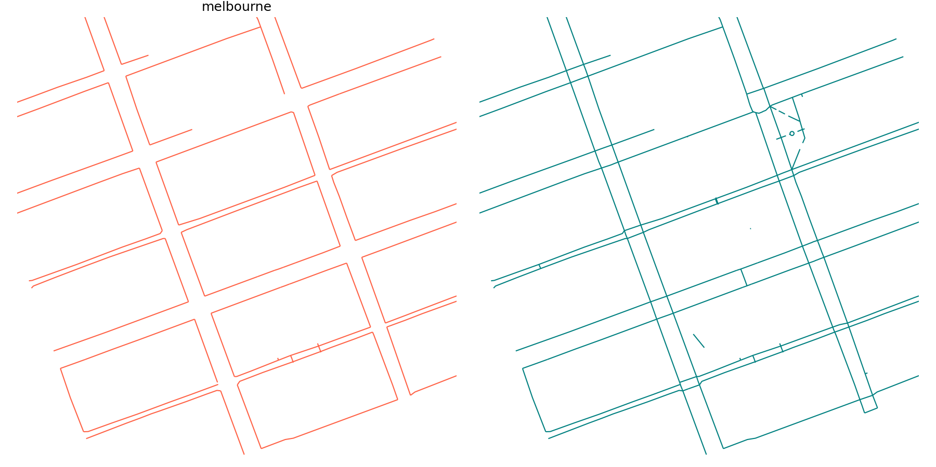
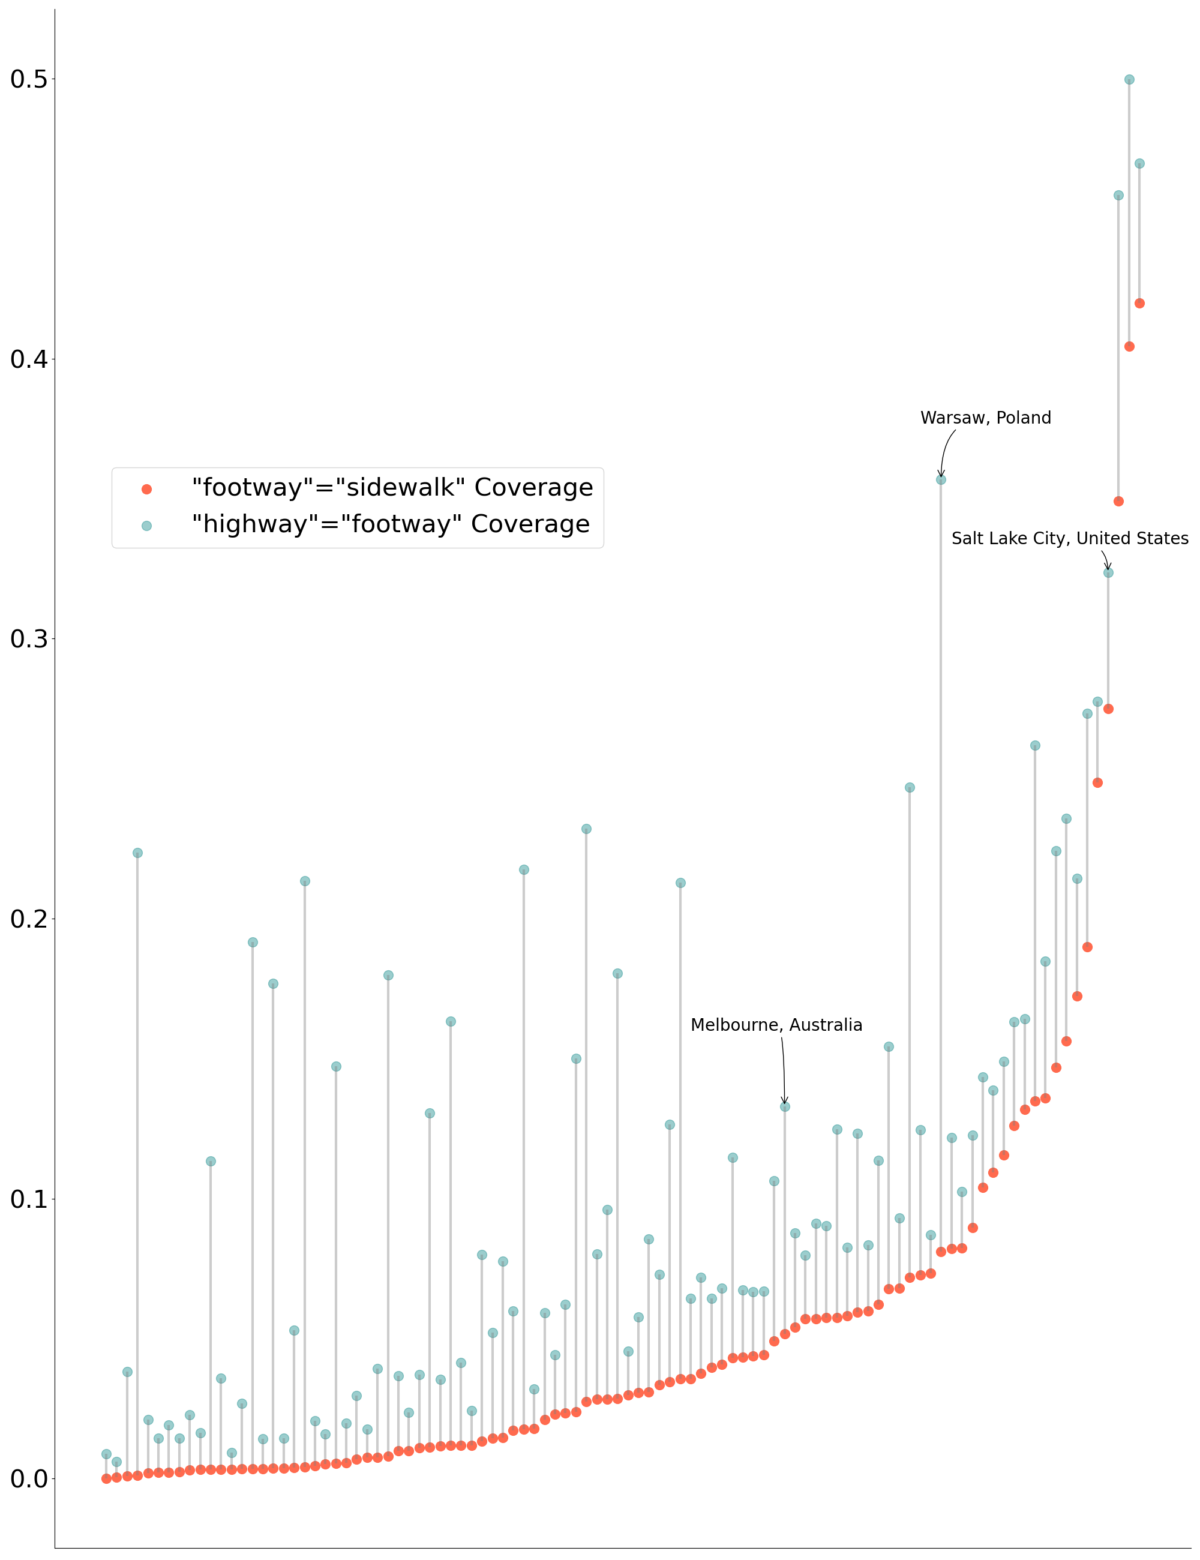
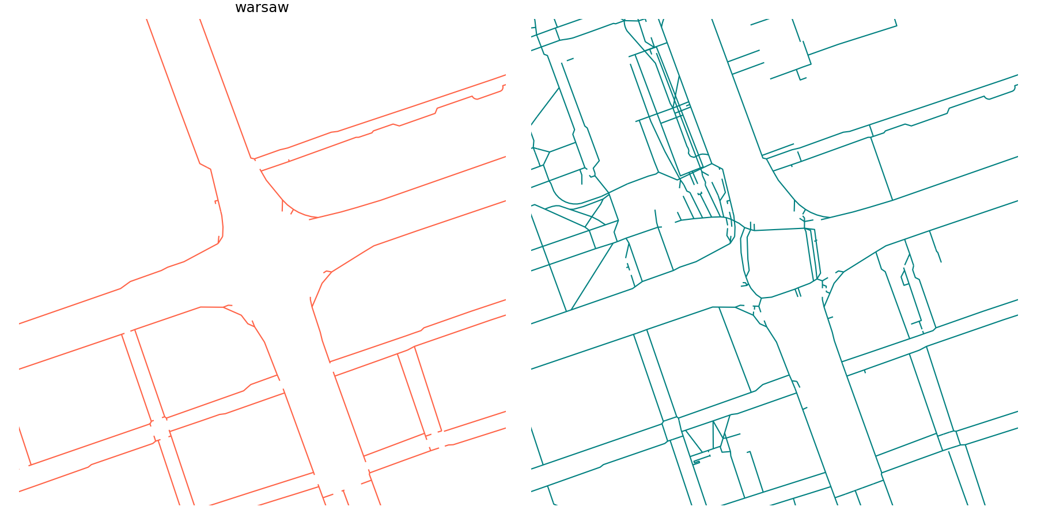
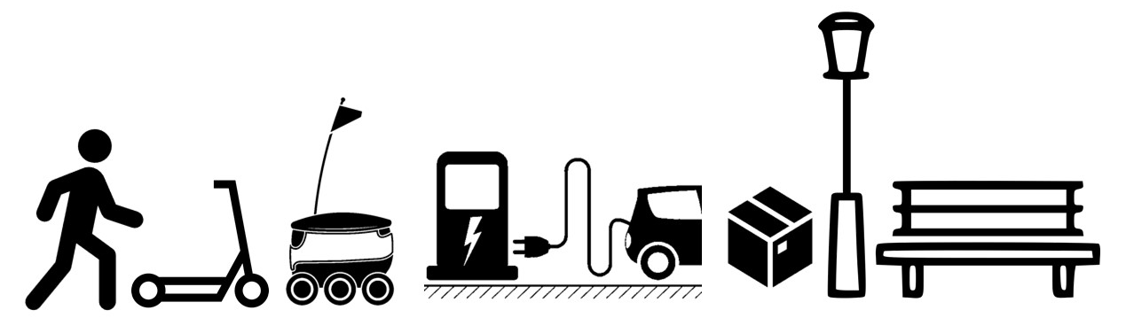
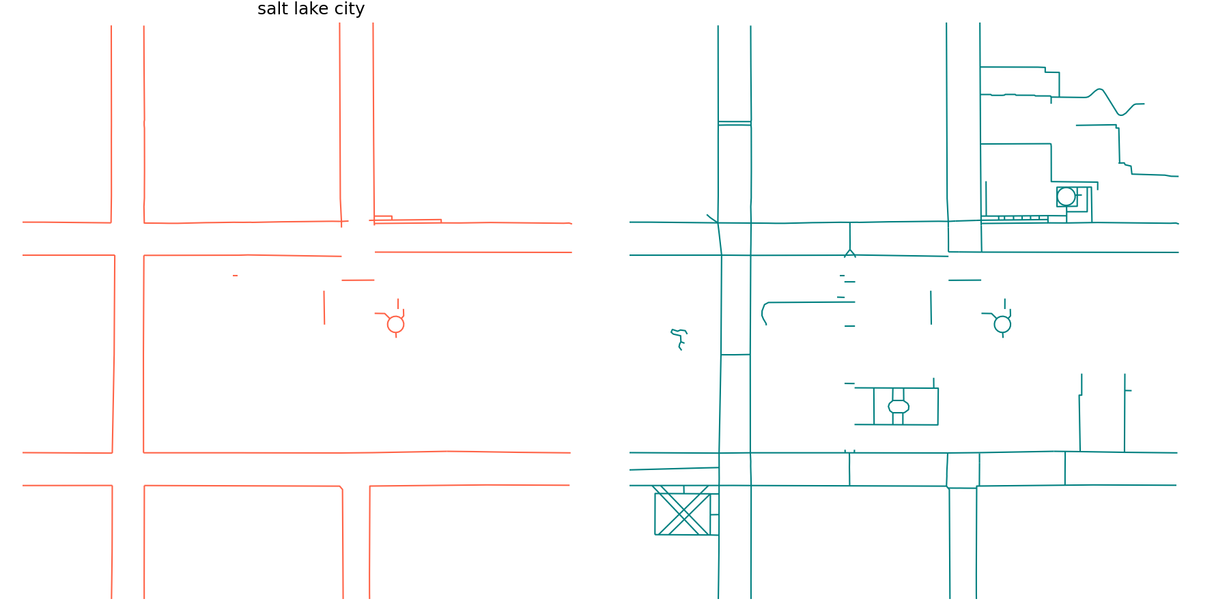

Mapping the space between buildings using Open Street Map
Obi Thompson Sargoni, Hannah Gumble, Nicolas Palominos
The Bartlett Centre for Advanced Spatial Analysis, University College London
Defining Streets (a manifesto)
In urban areas buildings should be accessible by foot or wheelchair. The spaces between buildings should provide space and infrastructure suitable to these modes. Digital representations of this infrastructure should help evaluate this objective.
1. San Jose, US
2. Vancouver, CA
Streets in Open Street Map
OSM recommends a hierarchy for defining pedestrian routes. The overarching tag “highway”=”footway” should be applied to all pedestrian specific routes. The more specific “footway”=“sidewalk” tag identifies routes along sidewalks/pavements. Geometries with this tag map the ‘pavement centre line’. Alternatively, road centre line geometries can be assigned the “sidewalk”= “both|left|right|no” tags, indicating the availability of pedestrian infrastructure without adding geometries.
Whilst a street can be represented by a one-dimensional road centre line geometry, understanding a ‘place’ effectively requires capturing activities across two and three dimensions. Furthermore, one-dimension representations are insufficient for assessing increasingly contested urban street space allocation. Of the tags listed above, only “footway”=“sidewalk” OSM features explicitly extend the one-dimensional representation of streets by identifying pavement centre line geometries.
We make an initial assessment of the availability of pavement centre line geometries in OSM using a sample of 99 cities worldwide and compare this to the coverage of all ‘footways’ and of road centre lines with ‘sidewalk’ tags. For each city we calculate the coverage of footway and sidewalk tagged geometries by dividing the total length of these geometries by twice the total length of the walkable road network, also downloaded from OSM.
Function
Infrastructure
Mapping
Access
Movement
Public Realm
The spaces ‘between’ buildings.
Pavement Centre Lines: ‘Sidewalks’
Walking routes: ’Footways’
3. Raleigh, US
4. London, CA
Walkable Road Centre Line Geometries | Pavement Centre Lines
["highway"]["area"!~"yes"] ["highway"!~"abandoned|bus_guideway|construction| cycleway|motor|planned|platform| proposed|raceway|pedestrian|footway"] [“footway”!~ “sidewalk”] ["foot"!~"no"]["service"!~"private"] | “footway”=“sidewalk”
 | Road Centre Lines with Sidewalks
 | “sidewalk”= “both|left|right”
Melbourne, AUS
Region | N Cities | Footways Coverage | Pavement Centre Line Coverage | Road Centre Line with Sidewalks Coverage
US + Canada | 57 | 0.124 | 0.084 | 0.042
Europe | 18 | 0.181 | 0.023 | 0.063
Brazil | 10 | 0.026 | 0.004 | 0.016
Australia + New Zealand | 9 | 0.082 | 0.001 | 0.010
China | 5 | 0.037 | 0.008 | 0.004
Buildings
Road Centre Line
Pavement Centre Line
Streets and Sustainability
The sustainable mobility paradigm¹ creates demand for spatial information by emphasising the links between land use and transport planning. For example, the link and place function² categorisation of urban roads highlights the role of roads as places in themselves, increasing the need to understand public space design and features of the urban realm encompassed in the space “between buildings^{”3}.
Furthermore, emerging transport innovations are increasing the demand for diverse high-resolution geographic information. The introduction of single rider vehicles (micromobility) and increased transport network connectivity through mobility-as-a-services (MaaS) platforms exemplify such innovations. The resulting diversified use of streetspace creates competing demands, motivating the need to measure streetspace.
Banister, D. "The sustainable mobility paradigm." Transport policy 15.2 (2008)
Jones, P., Boujenko, N., & Marshall, S. (2007). “Link & Place—A guide to street planning and design” Landor.
Gehl, Jan. “Life between buildings”. Vol. 23. New York: Van Nostrand Reinhold, 1987
Aderson, J et al. ‘Corporate Editors in the Evolving Landscape of OpenStreetMap’ ’, ISPRS International Journal of Geo-Information, 8(5), p. 232
Comparing coverage of
“footway”=“sidewalk” and “highway”=“footway”
Warsaw, POL
Conclusions
Overall we find that OSM lacks data on pedestrian specific routes along streets. At best, the length of pavement centre line geometries mapped in OSM reaches around 40% of the mapping potential (assuming that both sides of every walkable road have a sidewalk), which we observe for San Jose, US and Vancouver, CA.
The figure to the left shows the large differences in coverage of “footway”=“sidewalk” and “highway”=“footway” features. This could be due to a lack of detailed tagging of geometries to distinguish between all pedestrian routes and those specifically on sidewalks, or to the city having many mapped pedestrian-only paths such as those through parks. While this distinction is not critical for routing purposes, assessing the competing demands on street space requires specifically identifying paths along city streets shared with many other transport modes.
We observe a trend of greater pavement centre line coverage in North American cities which are known to be car-dominated. We hypothesise that this could be due to the participation of OSM ‘corporate mappers' that aim to provide routing data for deliveries and logistics.⁴
Salt Lake City, US
Competing for pavement space
obi.sargoni.18@ucl.ac.uk
hannah.gumble.17@ucl.ac.uk
n.palominos@ucl.ac.uk

